Slide 1
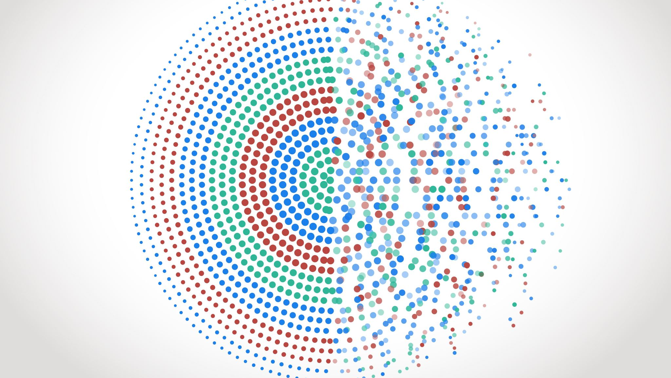
` ` `
Massachusetts General Hospital Project
By:
Data Analyst: Dennis Muli Kyambuu

Slide 2
Background Statement
Revolutionizing Healthcare Delivery through Innovative Software Solutions.
Massachusetts General Hospital Hospital (MHG) stands as a beacon of healthcare excellence, committed to providing top-notch patient care and advancing medical practices. However, in today's dynamic healthcare landscape, the demand for innovative technological solutions to enhance operational efficiency, elevate patient experiences, and streamline healthcare delivery has never been more pronounced.
Massachusetts General Hospital Hospital (MHG) is ranked as a top hospital in the nation by U.S. News & World Report 2023 - 2024

Slide 3
PROBLEM STATEMENT
Enhancing Hospital Operations through Innovative Software Solutions and Optimized Data Handling
In today's healthcare environment, hospitals face numerous challenges in optimizing patient care, operational efficiency, and data management. Despite technological advancements, there's a pressing need for innovative software solutions tailored to address critical pain points within our hospital ecosystem.

Slide 4
To establish a Clinical Data Warehouse for Massachusetts General Hospital (MGH), integrating electronic health records (EHR) data to enhance performance measurement and healthcare quality. The goal is to develop an ETL (Extract, Transform, Load) solution for seamless data extraction, validation, and storage, providing accessible corporate information and hospital statistics. This initiative aims to empower directors, management, and authorized personnel with comprehensive insights into various aspects of patient care, administration, and research, ultimately fostering improved healthcare outcomes and quality.
Mission Statement

Slide 5
PROPOSED SOLUTION MODEL
MGH MOBILE APPLICATION

Slide 6
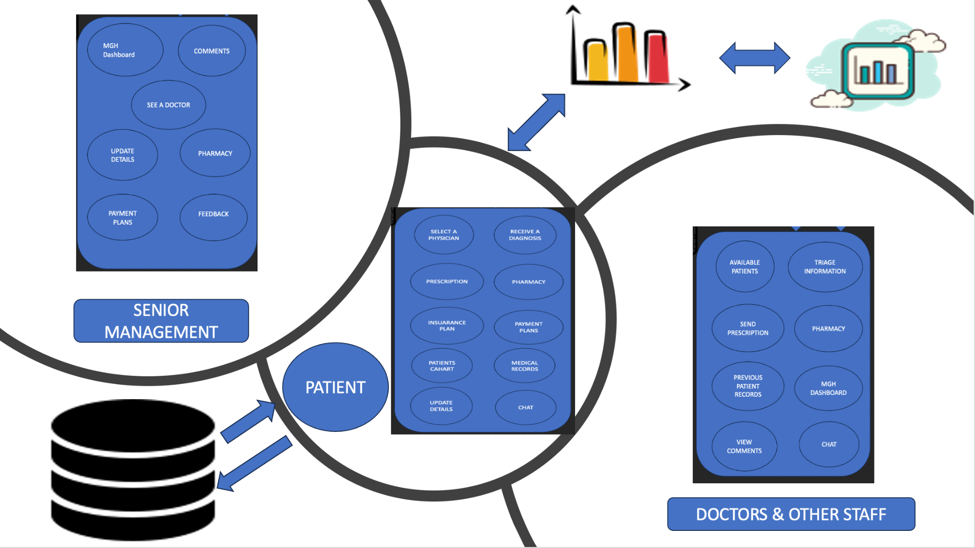

Slide 7
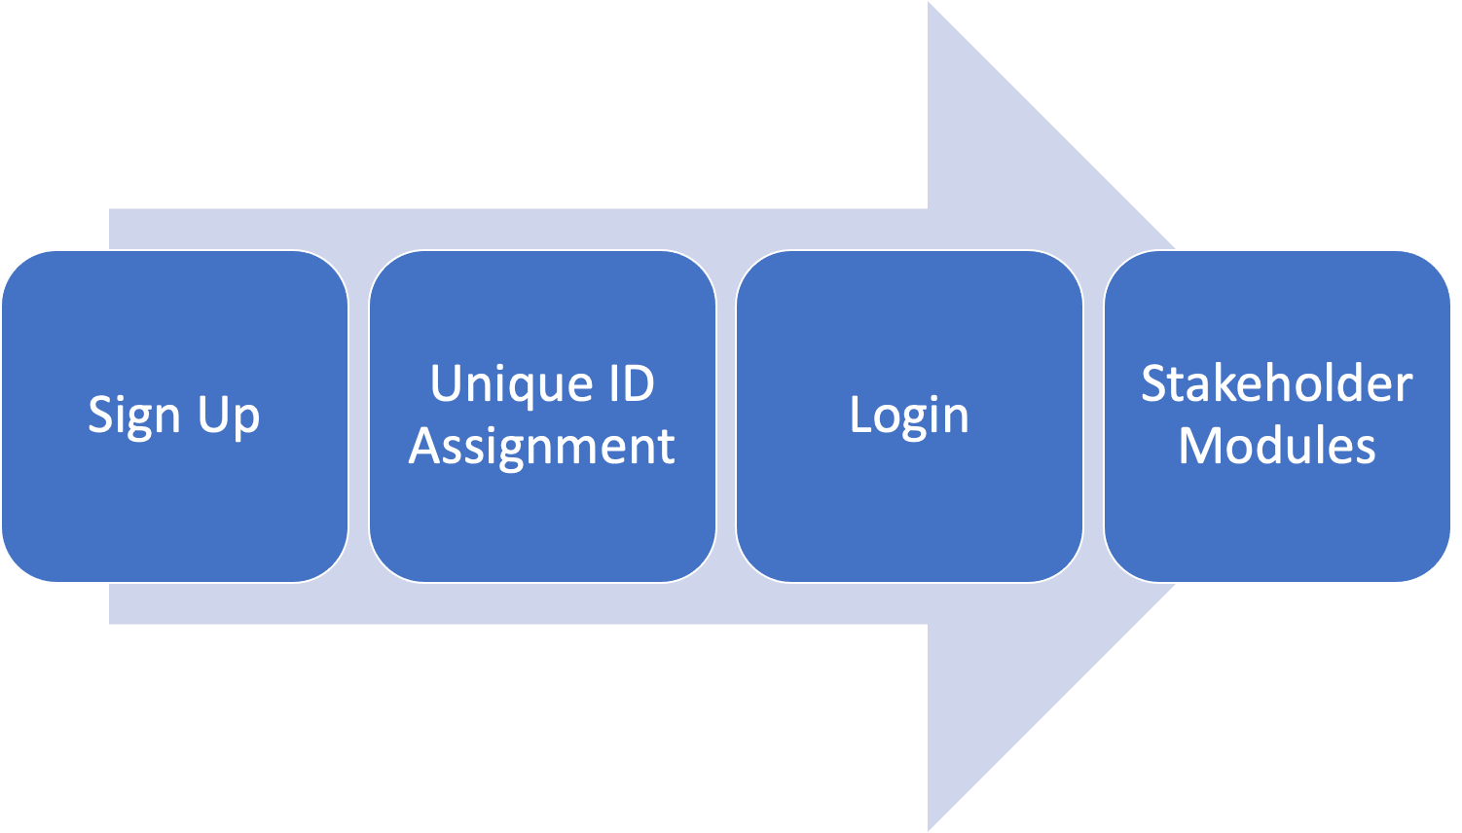
Functionality Flow

Slide 8
BENEFITS
1. Improved Patient Experience:
• Convenient access to MGH services via mobile.
• Remote care capabilities reduce physical visits.
________________________________________
2. Streamlined Hospital Operations:
• Efficient patient management (registration, admission, discharge).
• Enhanced staff communication and collaboration.
________________________________________
3. Data-Driven Decision Making:
• Integration of EHR for informed clinical decisions.
• Real-time data analytics for senior management.
________________________________________
4. Accessibility & Convenience:
• Anytime, anywhere access for stakeholders.
• Automated reminders boost appointment adherence.
________________________________________
5. Cost Savings:
• Process streamlining reduces administrative costs.
• Telemedicine cuts patient travel expenses.
________________________________________
6. Scalability & Growth:
• Modular design adapts to evolving needs.
• Regular updates support future innovations.
________________________________________
7. Patient-Centric Care:
• Personalized experiences & tailored communication.
• Empowering patients for proactive health management.
________________________________________
8. Operational Efficiency:
• Automation of tasks enhances staff productivity.
• Seamless system integration minimizes disruptions.

Slide 9




ETL PROCESS

Slide 10
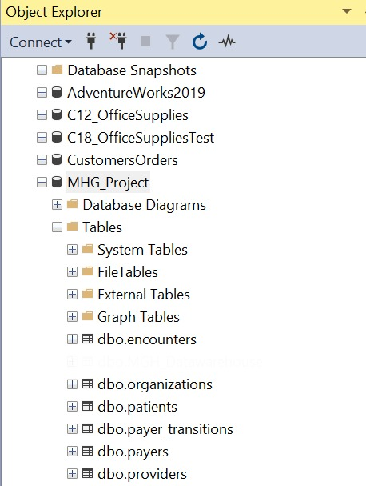
EXTRACT DATA
Extract data from Excel and moved data to SQL
`1. Data Profiling
Assessed the structure of the different excel tables
Assessed the various columns and established some relationships for future reference
Brought in all tables into SQL

Slide 11
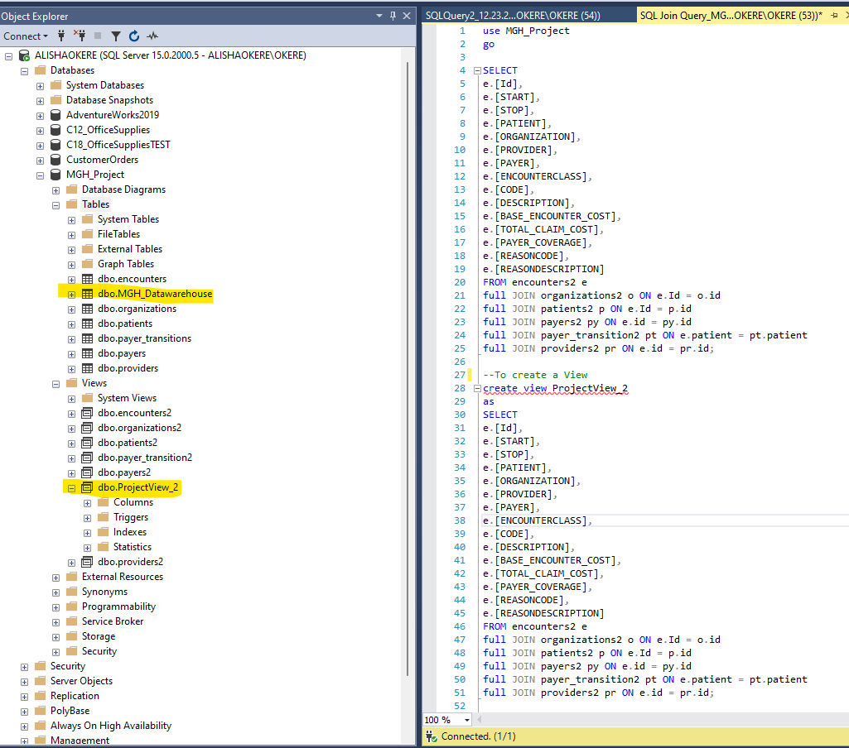
TRANSFORM DATA
Used SQL tool
`1. Data Manipulation
Assessed the structure of the different excel tables
Assessed the various columns and established some relationships for future reference
Changed the data types relevantly
Removed Nulls and Used Cast Functions
Applied Joins where necessary

Slide 12
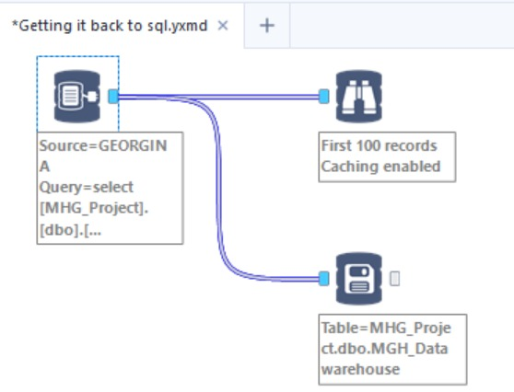
LOAD DATA
Used Alteryx tool
`1. Data Enrichment
Brought in transformed data from SQL
Created a DATA WAREHOUSE
Imported the Data Warehouse to SQL to prepare for visualization

Slide 13
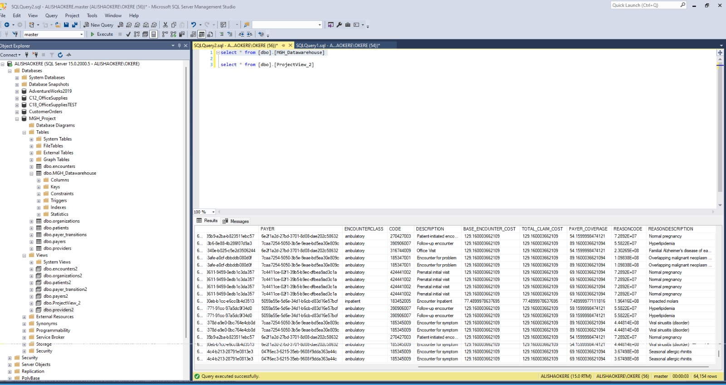
Ensure that the data processed in Alteryx has undergone comprehensive cleansing, normalization, and validation to meet the project's data quality goals.
Alteryx clean data was moved to SQL database. This approach helps maintain data integrity, reliability, and security throughout the transfer process, facilitating the utilization of high-quality data within the SQL environment for analysis, reporting, visualization, or any other project needs.
Imported ProjectView_2 data from SQL to Tableau for visualization.

Slide 14
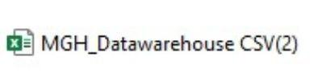
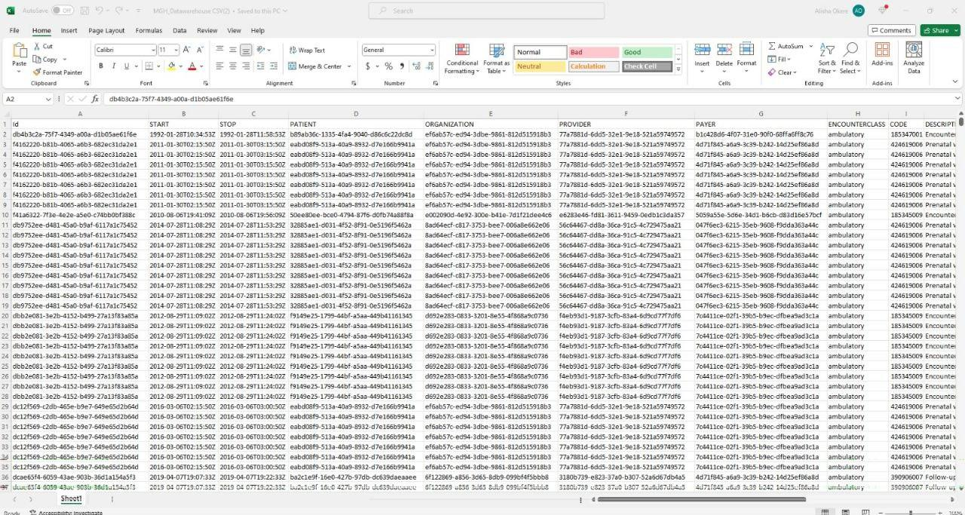
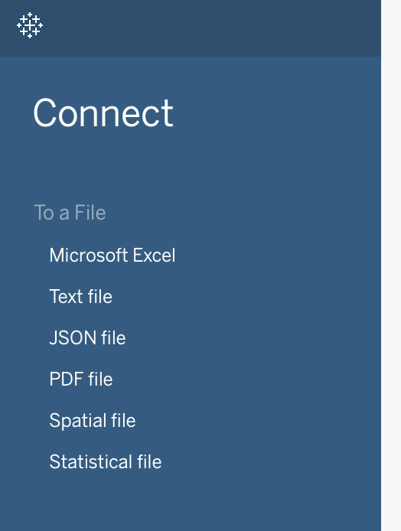
TABLEAU
Data Available in CSV format
Imported CSV file into Tableau

Slide 15
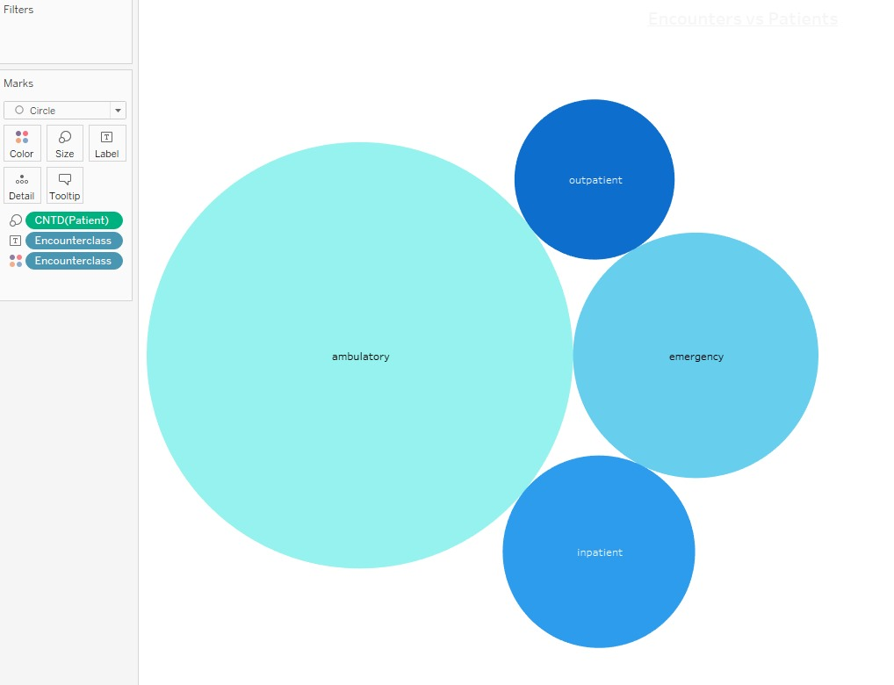
Tableau Analytics
Encounters Class Vs Patients: Resource Intensity

Slide 16
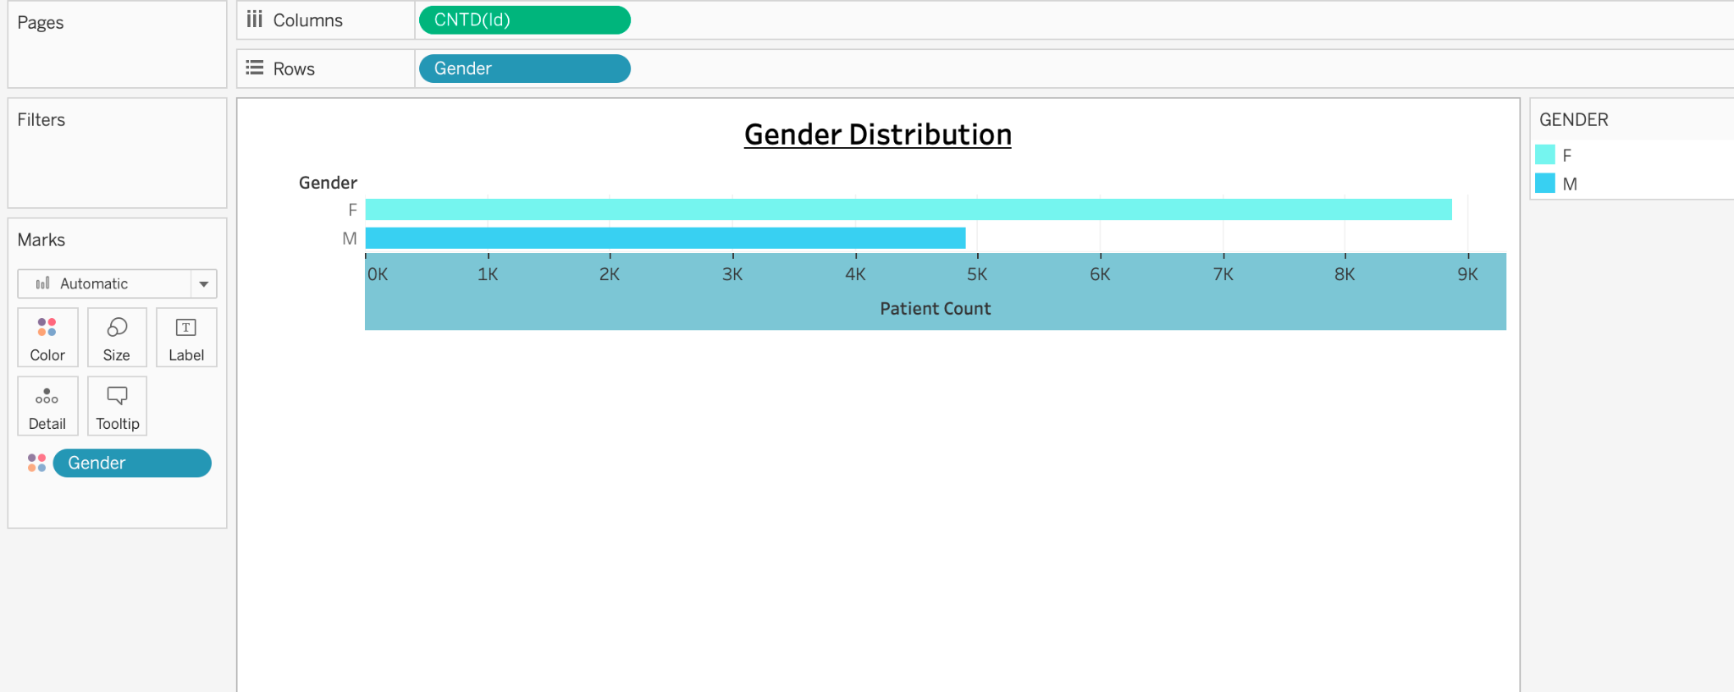
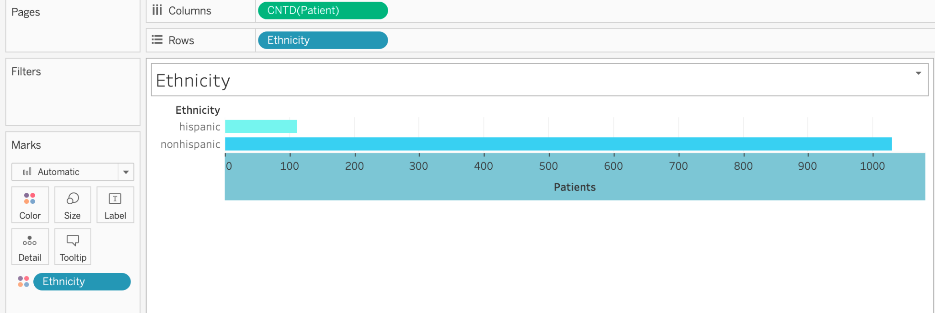
Distribution Statistics

Slide 17
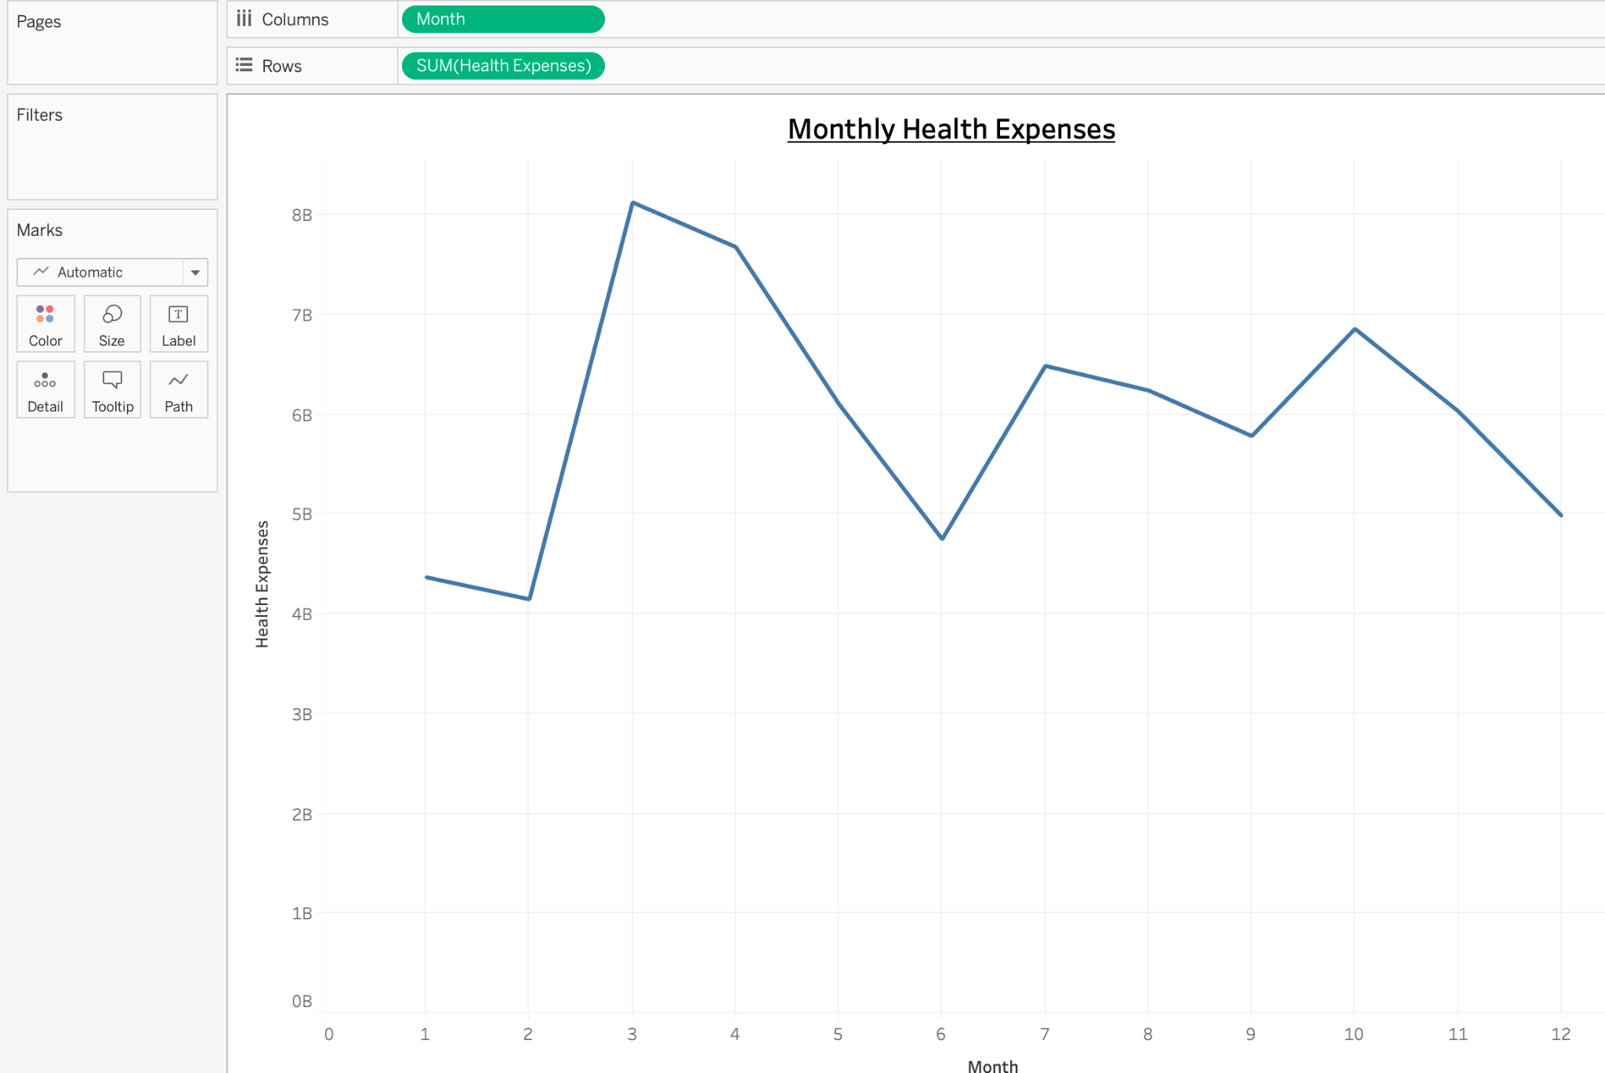
Time Trends
Different trends for different seasons

Slide 18
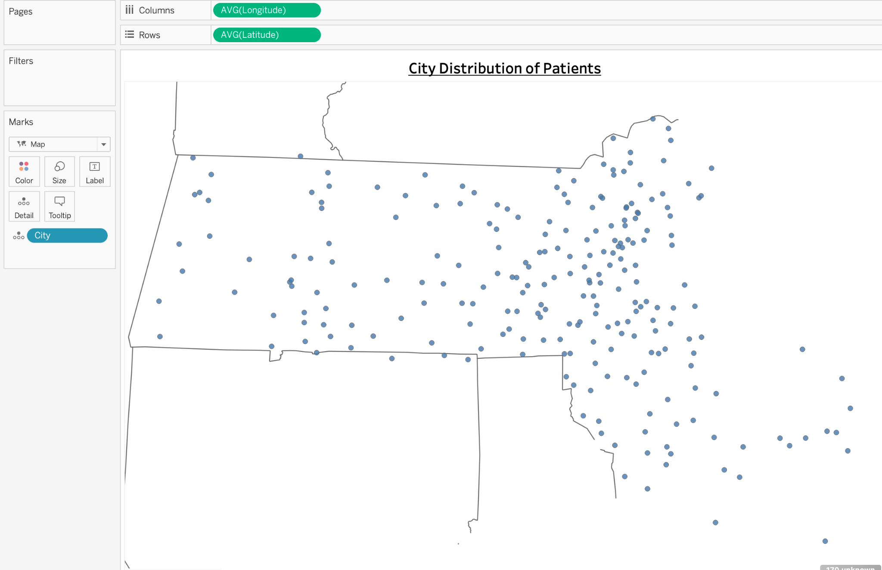
Demographics

Slide 19
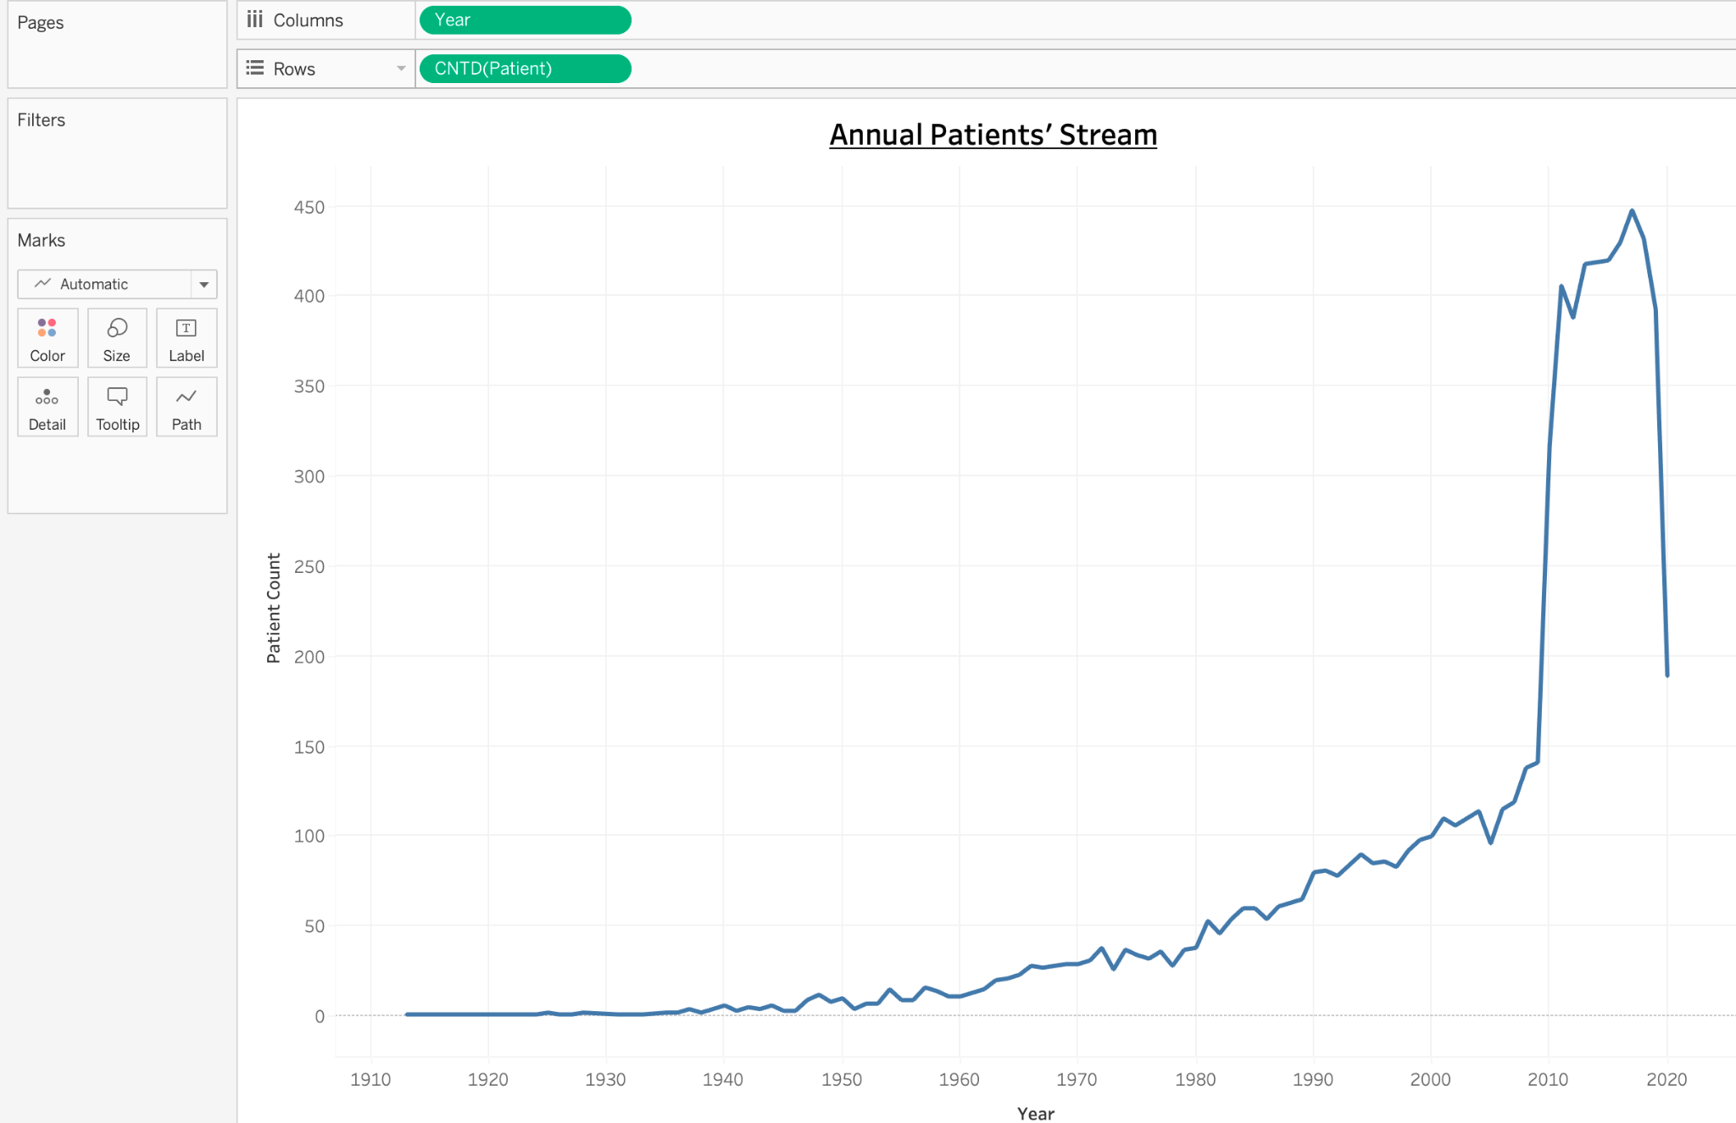
Operational Statistics
Upward Stream of patients and a notable Downward Stream in 2017

Slide 20
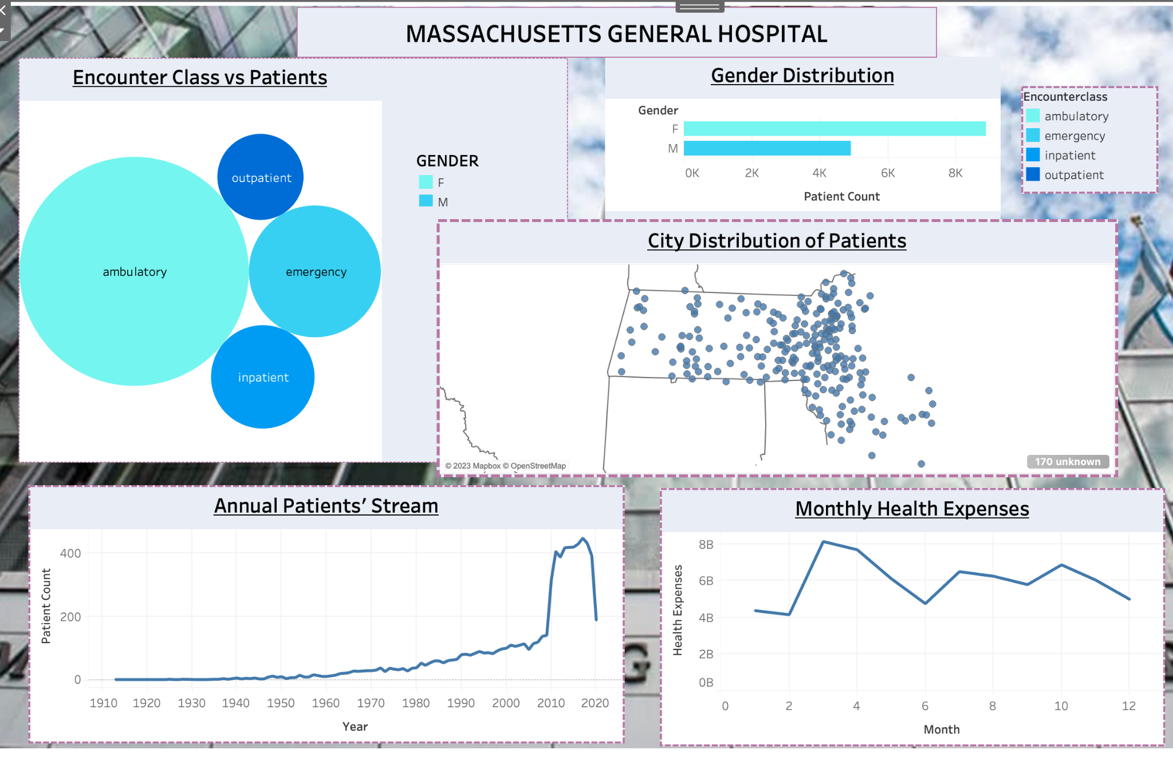
Dashboard Overview

Slide 21

Python/Machine Learning | Prediction of Heart Disease
Import relevant libraries
Load the data into Python using read command
View all columns, information, descriptions, headers of the data
Drop all columns excluding ‘totoChol’ and ‘diaBP’ to get X-axis
Use ‘TenYear CHD’ to obtain y-axis, which is our prediction
Split the X-axis and y-axis. Using 20% for training and 80% for testing
Fit model using DecisionTreeClassifier
Tested the prediction for accuracy, that gives 85%
Load the model to make predictions
Plot the predictions using Histogram and Cmap

Slide 22
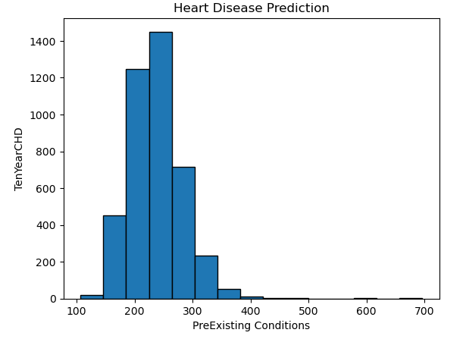

Slide 23
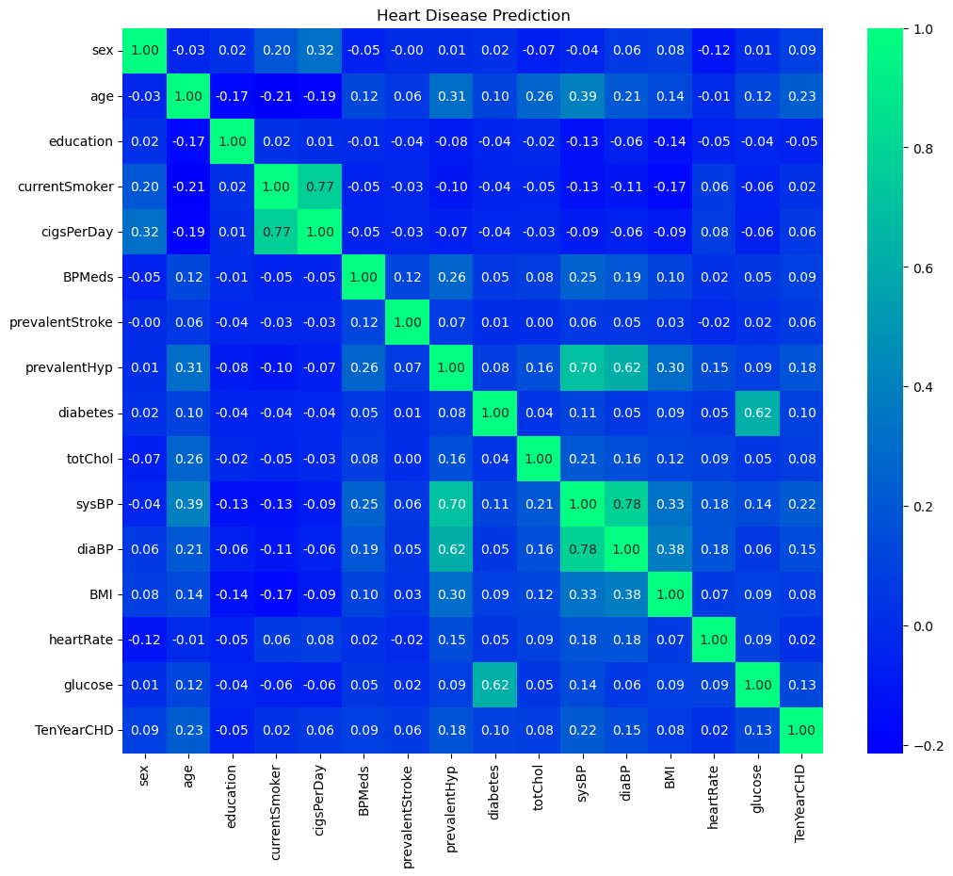

Slide 24
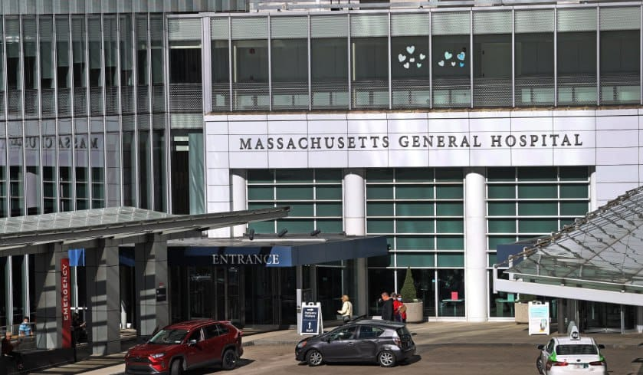


Thank you for listening to this presentation.
……

